Slide 1
RISC-V Instructions

Slide 2
Agenda
Intro to Assembly Languages
RISC-V Programming Paradigm
List of RISC-V Instructions

Slide 3
Agenda
Intro to Assembly Languages
RISC-V Programming Paradigm
List of RISC-V Instructions

Slide 4
Building a computer from the ground up
Ultimately, any program we write needs to run on a circuit in order to be useful.
However, circuit-level programming is highly restrictive.
With C, someone designed the programming language, so that person had full control over the operators allowed, and thus could choose how those operators were defined to be useful: the primitive components were defined to reflect the demands of the language.
Once you get to the circuit level, every primitive component we use is a piece of silicon that happens to behave in predictable and useful ways: the language needs to be defined to reflect the available components.
Early computers essentially had to be rebuilt for every program you wanted to run, since different computations required different circuits.
One major advancement in computer science was the creation of software-based languages. Instead of making a new circuit for every problem you want to solve, make a circuit (called a CPU) that solves the problem “Carry out a sequence of instructions stored as binary data”. Then solve your problem by writing instructions in binary data.

Slide 5
Assembly Language
We don’t want to change the CPU after we build it, so when designing our CPU, we need to decide on a specific set of instructions that will be supported by the CPU, along with a way to translate each instruction to a binary form.
Different CPUs implement different sets of instructions. The set of instructions a particular CPU implements is an Instruction Set Architecture (ISA), and the programming language defined by the ISA is commonly known as an assembly language.
e.g., Arm (mobile devices), Intel x86 (Core i9, i7, i5, i3), IBM/Motorola PowerPC (old Macs), MIPS/LoongArch, RISC-V, ...

Slide 6
Assembly Language
C is generally considered a “lower-level” language than Java or Python, because it’s “closer” to the underlying CPU
Less is automated by the language, so you get faster runtimes, but have to keep track of more things
Ultimately, though, C is still considered a high-level language, because there is still a lot done for you.
C lets you write a bunch of operations in a single line of code, and splits it up for you
C sets up the stack for you and keeps track of where it stored local variables
C lets you just call a function, and you can expect that calling functions won’t affect any local variables you have.
C lets you name variables, and will keep track of that name, and even the type of variable that name refers to.
Once you start working with assembly languages, almost everything is the result of an explicit instruction by the programmer.

Slide 7
Instruction Set Architectures
Early trend in ISA design was to add more and more instructions to new CPUs to do elaborate operations
VAX architecture had an instruction to multiply polynomials!
RISC philosophy (Cocke IBM, Patterson, Hennessy, 1980s) – Reduced Instruction Set Computing
Keep the instruction set small and simple.
Let software do complicated operations by composing simpler ones.
A simpler CPU is easier to iterate on (allowing for faster development), and can generally be made faster than a complex CPU (we’re often limited by the slowest instruction we decide to implement)

Slide 8
RISC-V
For the purposes of this class, we’ll be learning RISC-V as our assembly language
Why?
RISC-V is relatively simple, in that there’s only a few instructions in the base instruction set, and that instructions themselves follow a consistent format.
x86 is a more popular language (base CPU for most laptops/desktops), but is a CISC language that Huffman encodes its instructions
RISC-V is relatively popular, open-source, and growing in popularity
RISC-V was invented in Berkeley in 2010. If we teach students RISC-V, they’re more likely to use a RISC-V architecture in the future, thus allowing RISC-V to keep growing in popularity.

Slide 9
Agenda
Intro to Assembly Languages
RISC-V Programming Paradigm
List of RISC-V Instructions

Slide 10
Overarching view of RISC-V
A RISC-V system is composed of two main parts:
The CPU, which is responsible for computing
Main memory, which is responsible for long-term data storage
The CPU is designed to be extremely fast, often completing one instruction every nanosecond or faster
Note: Light travels 30 cm in 1 nanosecond. In other words, it takes longer for light to travel from one end of my laptop to the other, than it does for a CPU to finish one instruction.
Going to main memory often takes hundreds or even thousands of times longer.
The CPU can store a small amount of memory, through components called registers.

Slide 11
Registers
A register is a CPU component specifically designed to store a small amount of data. Each register stores 32 bits of data (for a 32-bit system) or 64 bits of data (for a 64-bit system). For the purposes of this class, we consider RV32 only (which uses 32-bit registers)
This data is purely binary; types do not exist at the assembly level, so if we use a register to store something, it’s the programmer’s responsibility to keep track of that register and its intended use.
Registers are a hardware component, so once you make the CPU, you can’t change the number of registers available.
RISC-V gives access to 32 integer registers

Slide 12
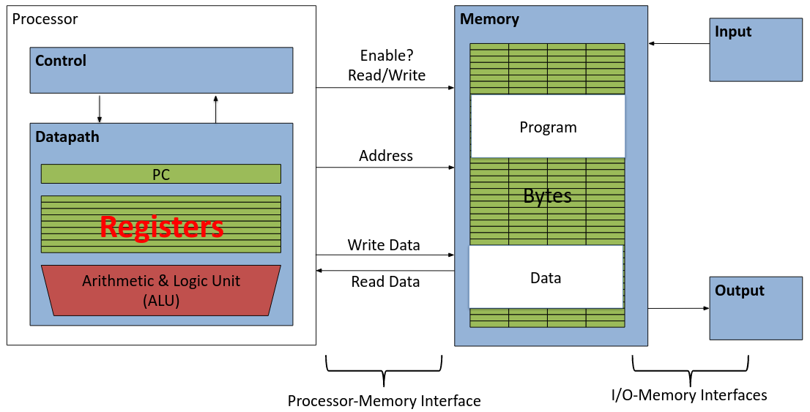
Aside: Registers are Inside the Processor

Slide 13
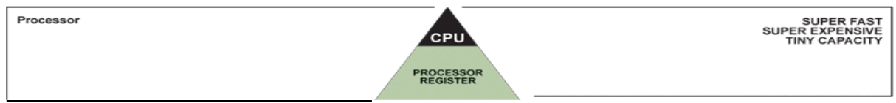
Great Idea #3: Principle of Locality / Memory Hierarchy

Slide 14
Registers
Registers are a hardware component, so once you make the CPU, you can’t change the number of registers available.
RISC-V gives access to 32 integer registers
Registers are numbered from 0 to 31
Referred to by number: x0 – x31
The register x0 is special and always stores 0 (trying to write data to that register results in the write being ignored). As such, we have 31 registers available for data storage
The other 31 registers are all identical in behavior; the only difference between different registers is the conventions we follow when using them.
Later, we’ll give them names to hint at what conventions get used on which registers.

Slide 15
Instructions
Each line of RISC-V code is a single instruction, which executes a simple operation on registers. ⇒ Check the source code of rv32emu (src/rv32_template.c)
Instructions are generally written in the format
<instruction name> <destination register> <operands>
e.g, “add x5,x6,x7” means “Add the values stored in x6 and x7, and store the result in x5”
Commas can be added between registers (“add x5,x6,x7”), but this is optional.
Comments are written using the # symbol.
Anything written after a # on a line gets ignored
Similar to Python comment syntax
Important: Comments are far more important in RISC-V than in other languages. In a higher level language, you can sometimes get away with choosing variable names so that the code is self-documenting. In RISC-V, we don’t have variable names!
Uncommented RISC-V code is practically impossible to debug properly. If you don’t comment your code, we may not be able to help debug in office hours.

Slide 16
Addition and Subtraction of Integers
Addition in Assembly
e.g., add x1,x2,x3 (in RISC-V)
Equivalent to: a = b + c (in C)
where C variables ⇔ RISC-V registers are: a ⇔ x1, b ⇔ x2, c ⇔ x3
Subtraction in Assembly
Example: sub x3,x4,x5 (in RISC-V)
Equivalent to: d = e - f (in C)
where C variables ⇔ RISC-V registers are: d ⇔ x3, e ⇔ x4, f ⇔ x5

Slide 17
Addition and Subtraction of Integers
How to do the following C statement? a = b + c + d - e;
Break into multiple instructions add x10,x1, x2 # a_temp = b + c add x10,x10,x3 # a_temp = a_temp + d sub x10,x10,x4 # a = a_temp - e
Notice: A single line of C may break up into several lines of RISC-V.
Notice: Everything after the hash mark on each line is ignored (comments).

Slide 18
Addition and Subtraction of Integers
How do we do this? f = (g + h) - (i + j);
Use intermediate temporary register add x5, x20,x21 # a_temp = g + h add x6, x22,x23 # b_temp = i + j sub x19,x5, x6 # f = (g + h)- (i + j)
Notice: By using x5 and x6 in this way, we overwrite any data that used to be in those registers. As such, we generally keep a few registers free (i.e., not containing any important data) to help with intermediate calculations.

Slide 19
Pseudo-instructions
Every instruction in our ISA needs some amount of circuitry, so we want to minimize our ISA as much as possible
There are, however, a few commands that are common enough that we want a shorthand for them, but which can be written using other instructions. In this case, we provide the name of the instruction, but they get turned into regular instructions by the assembler early on.
e.g., “mv x5,x6” is a pseudo-instruction that means “set x5 to x6”
Equivalent normal instruction: “add x5,x6,x0”

Slide 20
Immediates
Immediates are numerical constants.
They appear often in code, so there are special instructions for them.
Add Immediate:
addi x3,x4,10 (in RISC-V)
f = g + 10 (in C)
where RISC-V registers x3,x4 are associated with C variables f,g
Syntax similar to add instruction, except that last argument is a number instead of a register.

Slide 21
Immediates
There is no Subtract Immediate in RISC-V: Why?
There are add and sub, but no addi counterpart
Limit types of operations that can be done to absolute minimum
if an operation can be decomposed into a simpler operation, don’t include it
addi …, -X = subi …, X ⇒ so no subi addi x3,x4,-10 (in RISC-V) f = g - 10 (in C)
where RISC-V registers x3,x4 are associated with C variables f,g

Slide 22
Register Zero
One particular immediate, the number zero (0), appears very often in code.
So the register zero (x0) is ‘hard-wired’ to value 0; e.g., add x3,x4,x0 (in RISC-V) f = g (in C)
where RISC-V registers x3,x4 are associated with C variables f, g
Defined in hardware, so an instruction add x0,x3,x4 will not do anything!

Slide 23
Agenda
Intro to Assembly Languages
RISC-V Programming Paradigm
List of RISC-V Instructions

Slide 24
Instruction types
Instructions fall in 5 categories:
Arithmetic Operators

Slide 25
Arithmetic Operators
Generally for doing math between registers or between a register and an immediate.
The following operations are available in the base RISC-V instruction set:
Addition/Subtraction: add, sub, addi
Bitwise: and, or, xor, andi, ori, xori
Shifts: sll (Shift Left Logical), srl (Shift Right Logical), sra (Shift Right Arithmetic), slli, srli, srai
Set Less Than: slt, sltu, slti, sltiu
Quick note on Set Less Than:
slt x5,x6,x7 means:
If the x6 < x7, then set x5 to 1. Otherwise, set x5 to 0
Comes in two versions: slt (treat the operands as signed numbers) and sltu (treat the operands as unsigned numbers). slti and sltiu are the same but with an immediate instead of x7.
Note: Multiplication/Division is NOT within the base instruction set
Takes O(n²) circuit components, so it gets put in an optional extension instead

Slide 26
Arithmetic vs. Logical Shifts
Logical Left shift: Move all bits to the left, appending zeros as needed
Logical Right shift: Move all bits to the right, prepending zeros as needed
Recall: When working with unsigned numbers, these are equivalent to multiplying by a power of 2 and dividing by a power of 2 (rounding down), respectively.
What if we want the same behavior for signed numbers?
For left shifts, nothing changes
For right shifts, adding 0s the front of a number will turn negative numbers into positive numbers

Slide 27
Arithmetic vs. Logical Shifts
What if we want the same behavior for signed numbers?
For left shifts, nothing changes
For right shifts, adding 0s the front of a number will turn negative numbers into positive numbers
Solution: If you right-shift a negative number, prepend with 1s instead to keep the number negative.
Why does this work?
If we had the number -3 stored with n bits, 2’s complement means this is equivalent to the unsigned bit pattern 2^{n}-3. e.g., the 16-bit pattern would be 0b1111 1111 1111 1101, and the 20-bit pattern would be 0b1111 1111 1111 1111 1101. Thus, to “extend” a negative number from 16 bits to 20 bits, we can prepend with 1s. The same principle applies when extending right shifts.
Note: Negative numbers have a 1 bit in the MSB
Conclusion: If we want to right-shift (or extend) a signed number, fill in the extra bits with the MSB to keep the same represented value. This is known as “sign-extension”

Slide 28
Logical Shifting
Shift Left Logical (sll) and immediate (slli): slli x11,x12,2 #x11=x12<<2
Store in x1 the value from x2 shifted by 2 bits to the left (they fall off end), inserting 0’s on right; << in C.
Before: 0b0000 0002 0b0000 0000 0000 0000 0000 0000 0000 0010
After: 0b0000 0008 0b0000 0000 0000 0000 0000 0000 0000 1000
Shift Right Logical (srl) and immediate (srli): Same behavior as before; prepend with 0s.

Slide 29
Arithmetic Shifting
Shift right arithmetic (sra, srai) moves n bits to the right (insert high-order sign bit into empty bits)
For example, if register x10 contained 0b1111 1111 1111 1111 1111 1111 1110 0111 = -25
If execute srai x10,x10,4, result is: 0b1111 1111 1111 1111 1111 1111 1111 1110 = -2
Unfortunately, this is NOT same as dividing by 2^{n}
Fails for odd negative numbers
C arithmetic semantics is that division should round towards 0
Note: There’s no “sla” because left shifts work the same regardless of if we use signed or unsigned numbers.

Slide 30
Instruction types
Instructions fall in 5 categories:
Arithmetic Operators
Memory

Slide 31
Memory Instructions
Allows data to be transferred from main memory to registers and vice versa.
Has a different syntax compared to arithmetic instructions
e.g., lw x5,12(x7)
Meaning: Interpret x7 as an address and add 12 (Note that since we don’t have types in RISC-V, we don’t do 12*sizeof(type)). Retrieve the next word of data (4 bytes), and save the result in x5.
e.g., sw x5,12(x7)
Meaning: Interpret x7 as an address and add 12. Overwrite the 4 bytes of memory at that location with the value currently stored in x5.

Slide 32
Load from Memory to Register
C code int A[100]; g = h + A[3];
Using Load Word (lw) in RISC-V: lw x10,12(x15) # Reg x10 gets A[3] add x11,x12,x10 # g = h + A[3]
Note
x15 – base register (pointer to A[0])
12 – offset in bytes
Offset must be a constant known at assembly time
If you wanted to do a variable offset, you would need to add it to the original address and offset by zero.
e.g., If we wanted to do A[i], we could do:
add x5,x15,x16 # Assume i stored in x16 lw x10,0(x5)

Slide 33
Store from Register to Memory
C code int A[100]; A[10] = h + A[3];
Using Store Word (sw) in RISC-V: lw x10,12(x15) # Temp reg x10 gets A[3] add x10,x12,x10 # Temp reg x10 gets h + A[3] sw x10,40(x15) # A[10] = h + A[3]
Note
x15 – base register (pointer)
12,40 – offsets in bytes
x15+12 and x15+40 must be multiples of 4

Slide 34
Loading and Storing Bytes
In addition to word data transfers (lw, sw), RISC-V has byte data transfers:
load byte: lb
store byte: sb
load/store half-word: lh, sh
Same format as lw, sw
e.g., lb x10,3(x11)
Interpret x11 as an address and add 3. Retrieve the next byte of data, and save the result in x10.
RISC-V also has “unsigned byte” loads (lbu, lhu) which zero-extends to fill register (normal lb and lh sign-extends). Why no unsigned store byte sbu?

Slide 35
Instruction types
Instructions fall in 5 categories:
Arithmetic Operators
Memory
Control

Slide 36
Control
Normally, when running RISC-V code, we always move to the next line of code
Control instructions instead specify a different line of code to run next.
Comes in two variants
Conditional jumps (Also called branches), which jump to the specified line only if a certain condition is met, and otherwise move to the next line
Unconditional jumps, which jump to the specified line no matter what.
e.g., bne x5,x0,Label
Meaning: compare x5 and x0. If the two are Not Equal, jump to the line of code marked Label. Otherwise continue to the next line of code.

Slide 37
Labels
One last piece of RISC-V syntax: When working with control instructions, we often need to specify a line of RISC-V code to jump to.
Label: A human-readable identifier for a particular line of code.
e.g., addi x5,x0,0 addi x6,x0,10 Loop: add x5,x5,x6 addi x5,x5,-1 bne x5,x0,Loop

Slide 38
Types of Branches
beq: Branch if the two registers have equal value
bne: Branch if non-equal
blt, bge, bltu, bgeu: Less than and “greater or equal”, along with unsigned variants.
Note: bgt is not an instruction, because if we wanted to do bgt x5,x6,Label, we could do blt x6,x5,Label instead.

Slide 39
Unconditional Jumps
Two versions, depending on if we want to jump to a label, or to an address saved in a register.
These instructions also reference the current Program Counter (or PC), which stores the address of the current line of code being run.
e.g., jal x1,Label (Jump and Link)
Meaning: Set x1 to PC+4 (the line of code immediately after the current line), then jump to Label
e.g., jalr x1,x5,0 (Jump and Link Register)
Meaning: set x1 to PC+4, then jump to the line of code at address x5+0
Pseudo-instructions exist for when we don’t need the link
“j Label” and “jr x1”

Slide 40
C Loop Mapped to RISC-V Assembly
int A[20];
int sum = 0;
for (int i=0; i < 20; i++)
sum += A[i];
add x9, x8, x0 # x9=&A[0]
add x10,x0, x0 # sum=0
add x11,x0, x0 # i=0
addi x13,x0, 20 # x13=20
Loop:
bge x11,x13,Done
lw x12,0(x9) # x12=A[i]
add x10,x10,x12 # sum+=
addi x9, x9, 4 # &A[i+1]
addi x11,x11,1 # i++
j Loop
Done:

Slide 41
Why we Link
e.g., jal x1 Label (Jump and Link)
Meaning: Set x1 to PC+4, then jump to Label
Links allow us to “return” to where we were before we jumped
Often used to mimic the behavior of functions:
main: addi x10,x0,5 jal x1,foo ... foo: ... jr x1
We jump to foo, and store the next line after that jump into x1. Later, foo runs “jr x1”, which jumps back to where x1 is pointing, effectively “returning”.
This lets foo act as a “function” (though there are critical differences)

Slide 42
Instruction types
Instructions fall in 5 categories:
Arithmetic Operators
Memory
Control
Miscellaneous

Slide 43
Miscellaneous Instructions
These instructions don’t fit in the other categories:
lui, auipc: Two instructions that act as “helpers” to let the pseudo-instructions “li” and “la” work. Rarely used independently.
li x5,0xDEADBEEF: Sets the register x5 to immediate value 0xDEADBEEF
la x5,Label: Sets x5 to the address of the line of code pointed to by Label
ebreak: Debugger-specific behavior. In some emulators, it stops program flow at this line to let you step in (similar to adding a breakpoint in other debuggers)
ecall: OS-specific behavior. Kind of a catch-all for anything the program can’t do on its own. Example behavior includes printing out data, and requesting memory via malloc.

Slide 44
Instruction types
Instructions fall in 5 categories:
Arithmetic Operators
Memory
Control
Miscellaneous
Extensions

Slide 45
RISC-V Extensions
RISC-V offers a number of extensions which may optionally be implemented by a CPU
Multiplication/Division extension (too slow for the base instruction set)
Float extension (requires significantly more circuitry)
Double extension (requires more circuitry AND 64-bit registers)
Other extensions for different use cases
mul x5,x6,x7: Multiply x6 and x7 together, and store the result in x5

Slide 46
Summary
Everything that we normally use when programming (variables, functions, loops) need to be constructed out of these instructions
RISC-V is also extremely easy to get wrong (no guardrails), so to ensure that everyone’s code is compatible, we need to follow a set of conventions.

